Slide 1
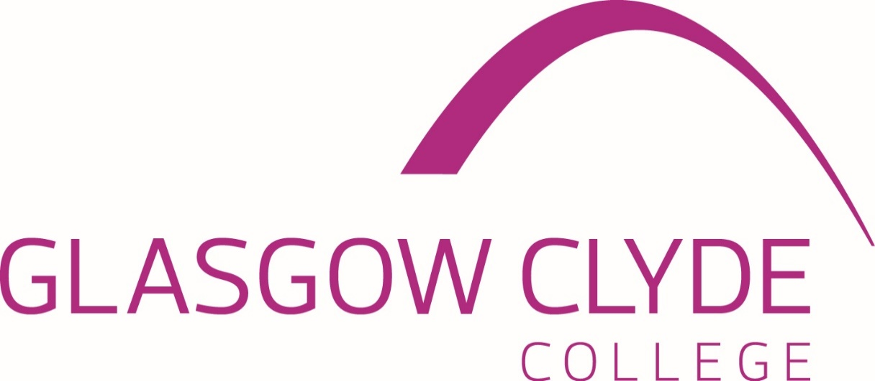
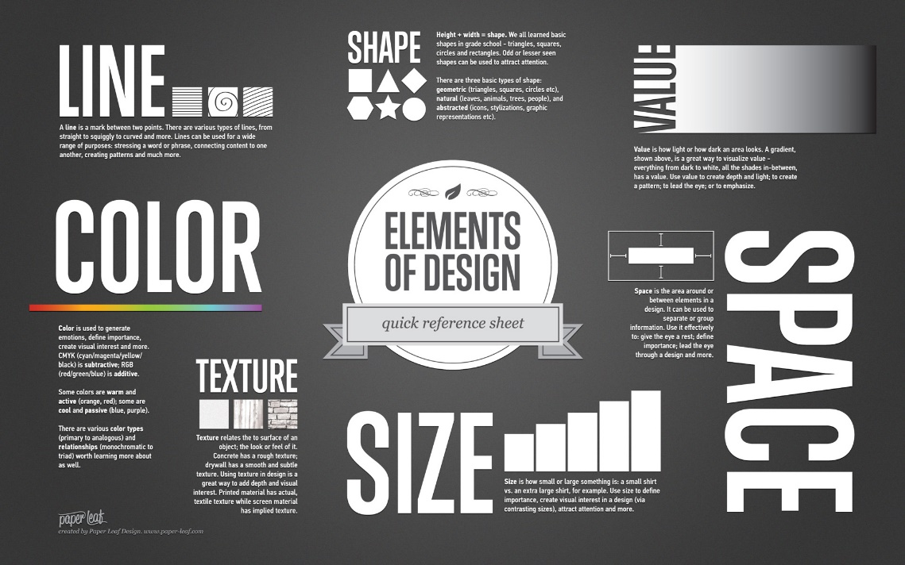
Graphic Design
Elements

Slide 2

Graphic Design Elements
Introduction
The principles of design suggest how a designer can best arrange the various components of a page layout to connect to the overall design and to one another.
All the principles of design, also known as principles of composition, apply to any piece you create. How you apply those principles determines how effective your design is in conveying the desired message and how attractive it appears. There is seldom only one correct way to apply each principle but check your document to see how well you applied each of these six principles of design.

Slide 3
Graphic Design Elements
Content
Lines
Shapes
Size, Scale & Proportion
Direction

Slide 4
Graphic Design Elements
Lines
Lines are the most basic of all the elements of design. Lines can be long or short, straight or curved. They can also be horizontal, vertical, or diagonal. Some lines are solid, dashed, thick, thin, or of variable width. A line's ending can be ragged, blunt, or curved.
The value of lines in graphic design cannot be understated. However you choose to combine them, lines tell a story and give a design its personality.

Slide 5
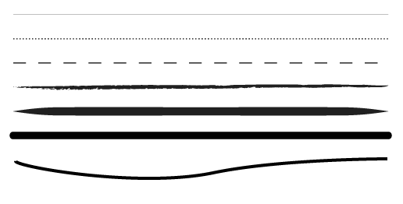
Graphic Design Elements
Lines
Take a look at the lines below and at how each one has its own personality. By varying thickness, curves and stroke width we can produce different feelings or ideas.

Slide 6
Graphic Design Elements
Lines
Frequently, lines are used in design to divide sections of a page or layout, and to join sections that are related to each other. On websites we see lines used to frame photographs, separate sidebars and join articles together.
Lines can create different effects and visual impact. While a thick, bold line draws attention because of its visual power, the thin lines tend to go the other way. The colour has an impact too, dark colours are easier to see and draw more attention than light or pale colours.

Slide 7
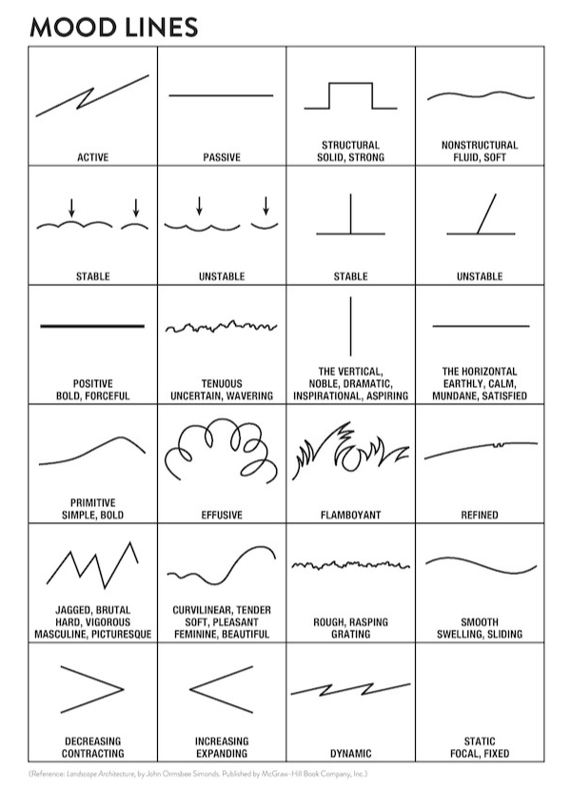
Graphic Design Elements
Lines

Slide 8
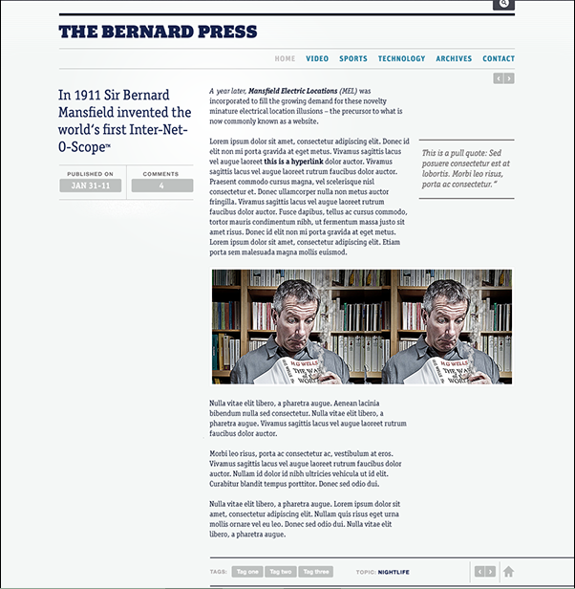
Graphic Design Elements
Lines

Slide 9
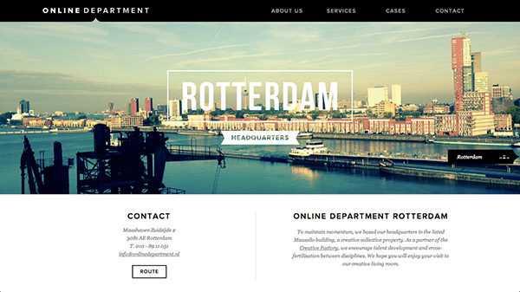
Graphic Design Elements
Lines

Slide 10
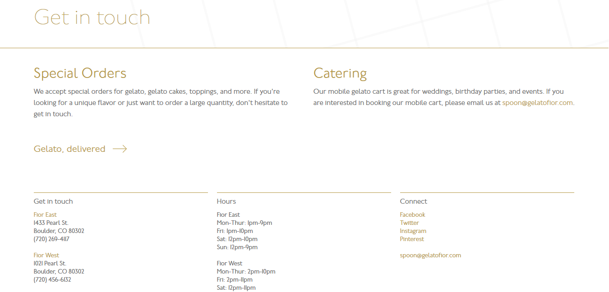
Graphic Design Elements
Lines

Slide 11


Graphic Design Elements
Lines

Slide 12
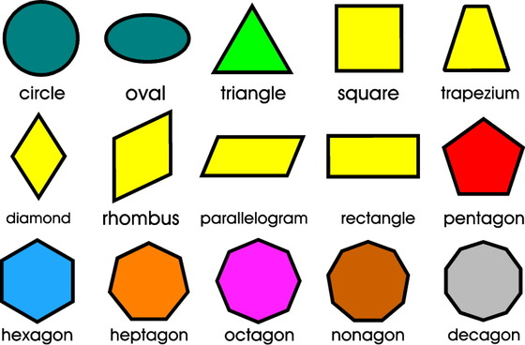
Graphic Design Elements
Shapes
The shape is the second most used element of a web design. They are actually lines combined in different shapes. The forms are still popular and this is because if there is something that needs to stand out, shapes are one of the ways to do it.
There can be circles, squares, rectangles, triangles or any other abstract shape; most of the designs include at least one of these. Minimalistic designs use it a lot, because they are often based on illustrations and drawings.

Slide 13

Graphic Design Elements
Shapes
Like lines, shapes are also associated by the human mind with different movements. For example, circles are associated with movement and nature, while squares are often seen as structured, basic designs. Just like with the lines, the colour, style, background or texture of a shape can totally change the viewer’s perception.

Slide 14
Graphic Design Elements
Shapes - Types
There are three basic types of shapes:
Geometric shapes
Organic shapes
Abstract shapes

Slide 15
Graphic Design Elements
Shapes - Geometric
Geometric shapes are your basic squares, rectangles, circles, triangles, and the like. These typically include sharp corners but may have rounded elements.
Most geometric shapes on Web pages are created through layout and CSS. Some common geometric shapes you include:
Squares and rectangles
Circles
Triangles
Diamonds

Slide 16
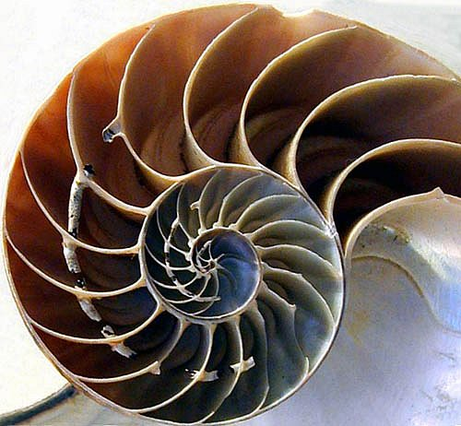
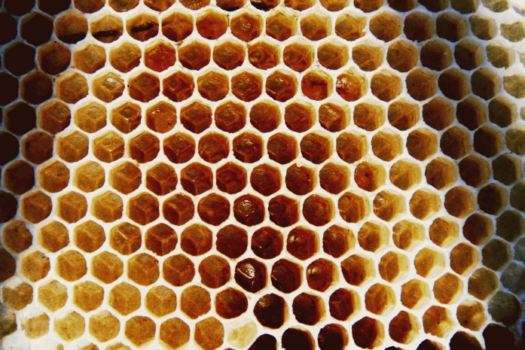
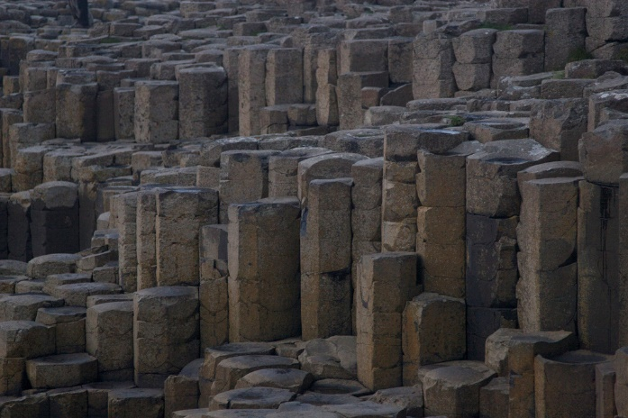
Graphic Design Elements
Shapes - Natural
Natural shapes have flowing lines and are also called “organic shapes." They resemble objects found in nature such as a pond (a squiggly blob), an apple, or a leaf. Most natural shapes in web pages are created with images.

Slide 17
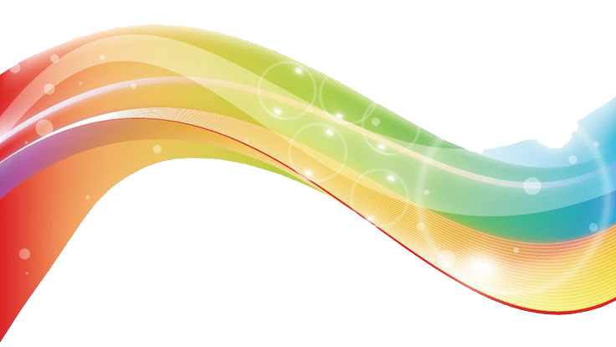
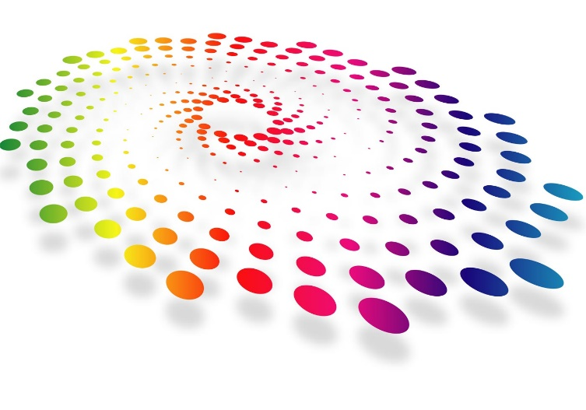
Graphic Design Elements
Shapes - Abstract
There are also those shapes which we cannot relate to reality known as abstract shapes. Abstract shapes are those that have a recognisable form but are not "real" in the same way that natural shapes are. For example, a stick-figure drawing of a dog is an abstract dog shape, but another dog in a photo is a natural shape. These are the freeform shapes like spirals, cloud-like formations, and multi-dimensional shapes that have become popular in modern logo design.
Abstract shapes in Web designs are usually added through images. Some examples of abstract shapes are:
Alphabet glyphs
Icons
Symbols

Slide 18
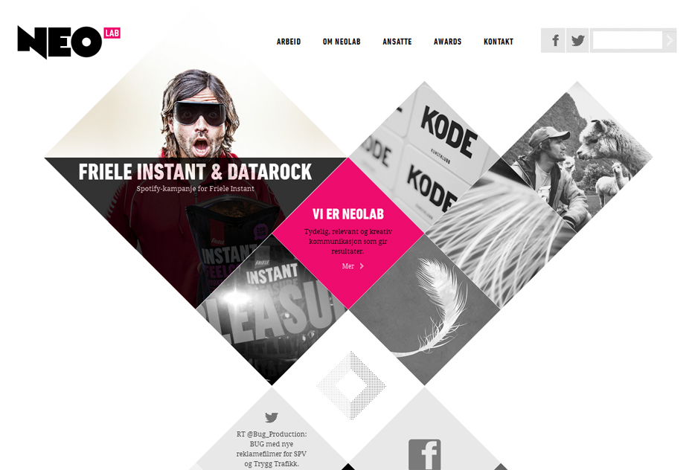
Graphic Design Elements
Shapes

Slide 19
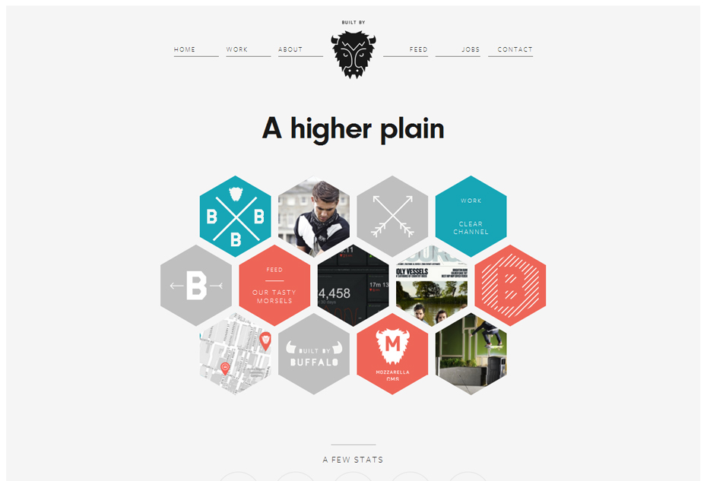
Graphic Design Elements
Shapes

Slide 20
Graphic Design Elements
Size, Scale & Proportion
In design when we talk about scale we’re usually talking about the quality of size, bigger and smaller, and the relationship of different design elements at different sizes. We’re also talking about proportion, which tells us how well we’ve scaled our design.
Size, scale, and proportion are all related concepts. Let’s define them quickly and then talk about each in a little more detail.
Size: the physical dimensions of an object
Scale: the relative size of different objects or of an object to a common standard
Proportion: harmony of scale

Slide 21
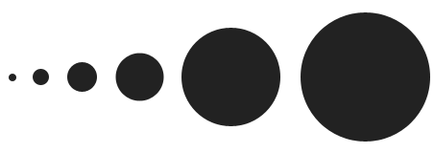
Graphic Design Elements
Size, Scale & Proportion
Web designers make a lot of choices about size. We determine the size of the overall page. We think about the size a sidebar should be as well as the size of the header and footer and main content area. We size images to fit within our design, set the size of the text on the page, and build the perception of mass through size.
Size is an absolute measurement. Your page might be 960px wide. Your font size might be 14px. Your header might have 150px of height. Every element on your page will display at some size.

Slide 22

Graphic Design Elements
Size, Scale & Proportion
Scale can be used to create the illusion of depth as larger elements tend to advance while smaller elements tend to recede into the background. Scale creates perspective in a composition. It can also be an effective way to create icons. Think of the standard RSS icon. It’s a series of three curves in scale all in relation to a dot.

Slide 23
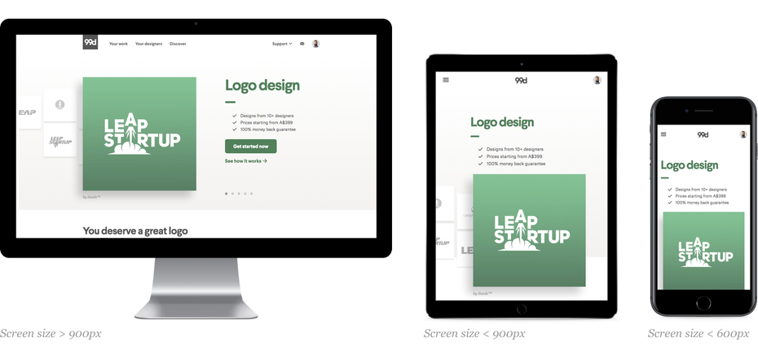
Graphic Design Elements
Size, Scale & Proportion
Proportion is the relationship between elements with respect to a comparative magnitude. It tells us whether or not our scale is in harmony, whether or not the different sizes of our elements are in agreement and balance. When one element of your design changes size, the others should also change size similarly if you want to keep them in the same proportion.

Slide 24
Graphic Design Elements
Direction
Among the elements of good page design for web is the concept of direction, which is closely aligned with movement. Elements in the page design intentionally guide the viewers' eyes from one area of the page to another. The three directions common in designs that are used to direct the eye are:
Horizontal
Vertical
Diagonal

Slide 25
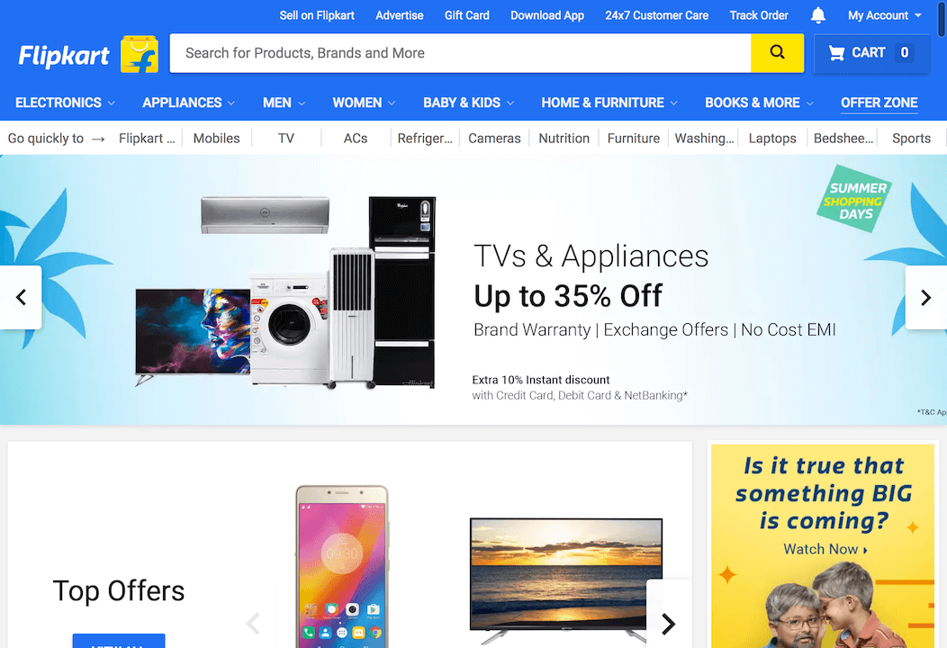
Graphic Design Elements
Direction
Horizontal - If you divide the screen in half from side to side with a line or other element, the eye moves to each element in the top half of the design before moving to the section under the horizontal line or element that divides the page.

Slide 26
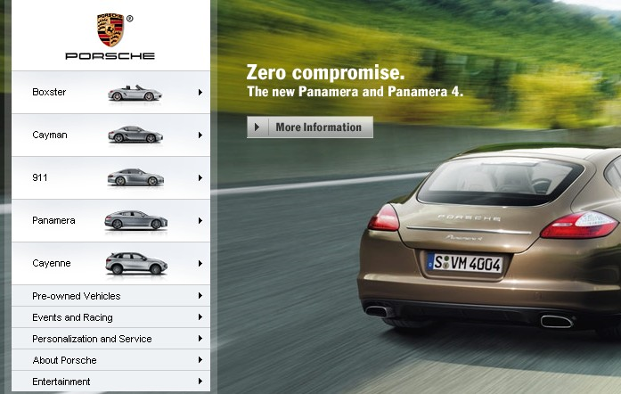
Graphic Design Elements
Direction
Vertical - If you have two long, narrow columns of text or two long narrow photos or graphic elements, you have a design with a vertical direction. The eye flows from the top of one column to its bottom and then moves to the top of the second column.

Slide 27
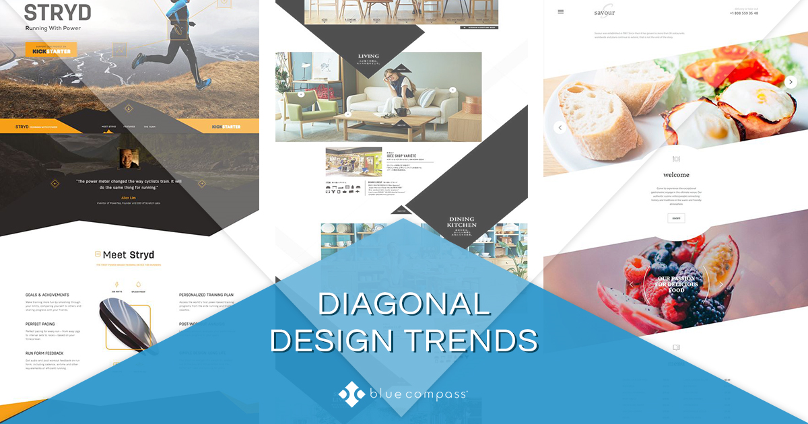
Graphic Design Elements
Direction
Diagonal - If you use diagonals or triangles in your design, the eye is captured, particularly on the web where you don't see many diagonal direction layouts.

Slide 28
Graphic Design Principles
References
Jacci Howard Bear. 2018. The Basics of Lines and How to Use Them in Design. [ONLINE] Available at: https://www.lifewire.com/lines-in-typography-1078106. [Accessed 21 December 2018].
Mydee Lasquite. 2018. What Makes Good Design? Basic Elements and Principles. [ONLINE] Available at: https://visme.co/blog/elements-principles-good-design/. [Accessed 21 December 2018].
Jennifer Farley. 2009. Elements Of Design: The Line. [ONLINE] Available at: https://www.sitepoint.com/elements-of-design-the-line/. [Accessed 21 December 2018].
Christian Vasile. 2018. Learning the Basic Elements and Principles of Graphic Design. [ONLINE] Available at: https://1stwebdesigner.com/graphic-design-basics-elements/. [Accessed 21 December 2018].
Orana Velarde. 2018. The Meaning of Shapes and How to Use Them Creatively in Your Designs Read more at. [ONLINE] Available at: https://visme.co/blog/geometric-meanings/. [Accessed 21 December 2018].
Stephen Peate. 2018. Getting your brand in shape: The psychology of logo shapes. [ONLINE] Available at: http://fabrikbrands.com/the-psychology-of-logo-shapes/. [Accessed 21 December 2018].

Slide 29
Graphic Design Principles
References
Karla Cook. 2018. The 7 Elements of Graphic Design, and How to Apply Them This Year. [ONLINE] Available at: https://blog.hubspot.com/marketing/elements-of-graphic-design. [Accessed 21 December 2018].
Jennifer Kyrnin. 2018. Using Basic Shapes in Graphic Design. [ONLINE] Available at: https://www.lifewire.com/shape-design-principle-3470055. [Accessed 21 December 2018].
Steven Bradley. 2010. How To Use Size, Scale, And Proportion In Web Design. [ONLINE] Available at: https://vanseodesign.com/web-design/size-scale-proportion/. [Accessed 21 December 2018].
Jennifer Kyrnin. 2018. Direction: Basic Element of Design. [ONLINE] Available at: https://www.lifewire.com/direction-design-principle-3470051. [Accessed 21 December 2018].

Slide 30
End of Presentation

